Slide 1



Find the job you love in 4 easy steps for FREE :
Create Profile
Search Jobs
DISC Personality Test
Workplace Culture Assessment
Skills Assessment
Core Values Assessment
Apply anywhere
Love your job

Slide 2
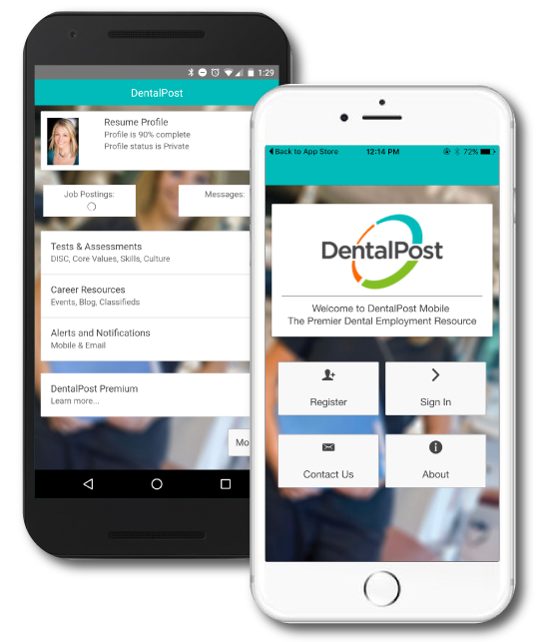



Download Our FREE App

